Slide 1

SWIGGY ANALYSIS
Adithyaa Swaminathan – MBE11

Slide 2
About the Company
Key Variables in the Dataset:
Company Overview: Founded in 2014, Swiggy has grown to become one of India's largest online food delivery platforms, known for its wide restaurant selection and fast delivery service.
Core Offerings: Swiggy provides food delivery from restaurants, Swiggy Genie (for instant parcel delivery), and Swiggy Instamart (for grocery and essentials delivery), making it a comprehensive convenience platform.
Coverage and Reach: Swiggy operates in over 500 cities across India, with a vast delivery network covering both urban and semi-urban areas, making it accessible to a diverse customer base.
Delivery Fleet: Swiggy has an extensive delivery fleet, with thousands of delivery partners working across various shifts to ensure quick and efficient delivery times.
ID: Unique identifier for each restaurant.
Area: Area where the restaurant is located.
City: City where the restaurant is located.
Restaurant: Name of the restaurant.
Price: Average price range.
Avg ratings: Average rating for the restaurant.
Total ratings: Total number of ratings received.
Food type: Types of food offered.
Address: Specific address details.
Delivery time: Estimated delivery time in minutes.

Slide 3
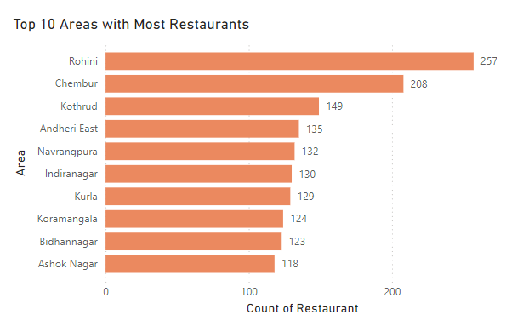
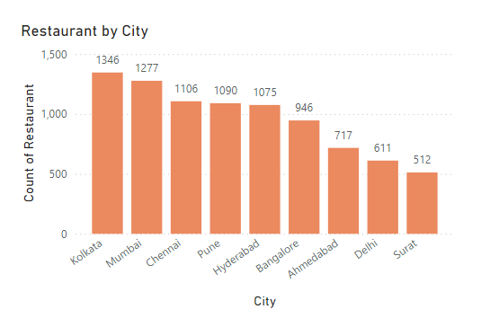
Exploratory Data Analysis
Kolkata tops the list with the most number of restaurants followed by Mumbai and Chennai
Rohini (Delhi) tops the list with the most number of restaurants followed by Chembur and Kothrud

Slide 4
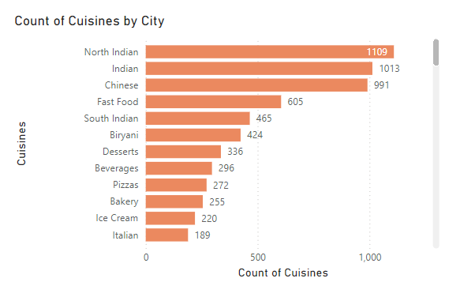
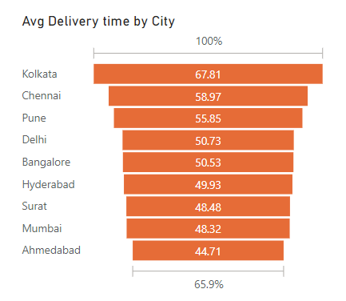
Average time taken by the restaurants to deliver the food. Kolkata tops the list with 67.81 minutes
The analysis shows that North Indian food tops list as it is widely ordered across cities

Slide 5
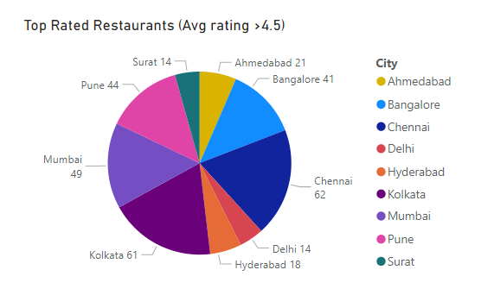
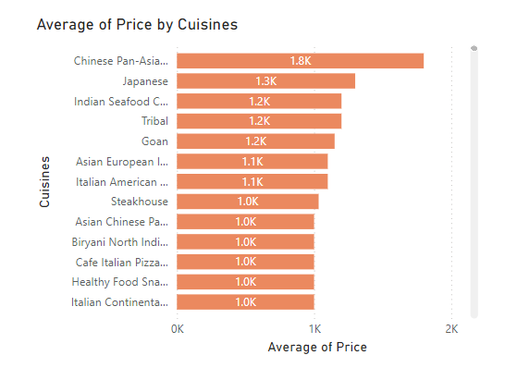
Chinese Pan-Asian tops the Cuisine’s list with an average price of 1800 INR followed by Japanese and Indian seafood
Chennai tops the list with 62 restaurants having an average rating of more than 4.5 followed by Kolkata and Mumbai

Slide 6
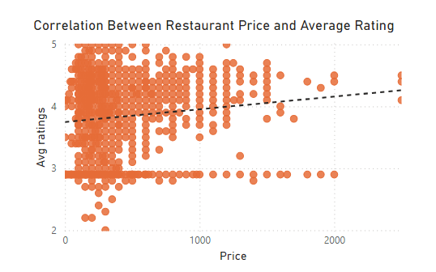
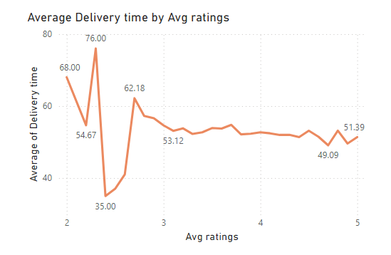
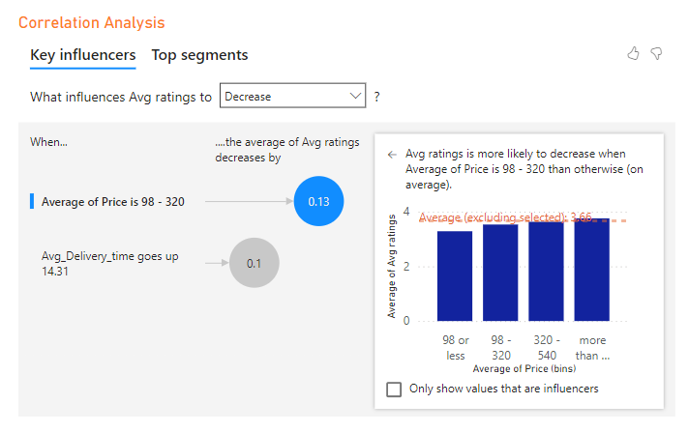
Based on the analysis below we can see the rating increases when the average delivery time decreases

Slide 7
Customer Insights
Top-Rated Food Types: Desserts, ice cream, and beverages rank highest, with average ratings close to 5.0.
Popular Food Types by Total Ratings: Chinese, North Indian, and Biryani receive the most customer engagement, indicating high popularity.
Top Areas by Rating: Girish Park, Vardhman Premium Mall, and Ekdalia are among the highest-rated areas.
Multi-Cuisine Combinations: Food types combining Chinese, Indian, and beverages tend to receive higher ratings, suggesting a favourable response to diverse options.
Fast Food and Combo Meals: Combo meal options that include fast food and beverages are well-rated, appealing to customers looking for quick and varied options.
Customer Engagement with Chinese Cuisine: Chinese cuisine, with the highest total ratings, reflects both popularity and consistency in customer satisfaction.
Price vs. Rating Trends: Additional analysis may reveal insights on how price impacts ratings, valuable for targeting customer segments more effectively.
Dessert Preference: High ratings for dessert-related categories indicate a strong preference for sweet options.

Slide 8

Operational Efficiency
Area-Specific Delivery Times: Identify areas with the shortest and longest average delivery times. This can help pinpoint logistical bottlenecks or high-performing regions for potential best practices.
City-Level Comparison: Compare delivery times across cities to identify if certain cities face systematic delays, which could indicate the need for city-specific strategies or additional resources.
Rush Hour Trends: Analyze if delivery times fluctuate during peak hours. This insight can guide staffing adjustments, such as increasing delivery personnel during high-demand periods.
Impact of Distance: Assess the correlation between the distance from the restaurant to delivery points in specific areas and the delivery times to optimize location-based logistics.
Traffic Patterns: Consider overlaying traffic data to understand if delivery delays align with high-traffic areas, leading to route optimizations or strategic placement of delivery staff.
Restaurant Performance: Evaluate if certain types of restaurants (like those with higher demand) consistently have longer delivery times, suggesting a need for dedicated resources or time-specific promotions.
Weather Impact: Look for patterns of delay during certain weather conditions to prepare better for adverse weather with additional delivery resources or extended delivery estimates.
Delivery Route Optimization: Examine if existing routes can be optimized by analyzing routes with the longest delays, possibly through clustering deliveries to nearby locations.

Slide 9

Market Positioning
High-Rated Area Identification: Identify areas with the highest average restaurant ratings to determine where customer satisfaction is strongest.
City Comparison: Analyze which cities have the most high-rated restaurants, indicating strong market positioning in terms of quality offerings.
Rating Density Mapping: Examine the concentration of high-rated restaurants in specific neighborhoods, revealing potential hotspots for quality dining.
Cuisine-Specific Performance: Determine if certain high-rated cuisines are concentrated in particular areas, helping identify where cuisine preferences align with quality.
Competitive Advantage Zones: Find areas with a high density of well-rated restaurants versus few competitors, which can represent an advantage in capturing quality-seeking customers.
Customer Loyalty: Evaluate if high-rated restaurants in certain areas have higher numbers of repeat customers, suggesting strong market positioning in those locales.
Demographics and Ratings: Cross-reference demographics with high-rated areas to understand which segments are more likely to appreciate higher-quality dining options.
High-Rated Restaurant Clusters: Identify clusters of high-rated restaurants within close proximity, potentially establishing a reputation for quality within these zones and drawing more foot traffic.
Expansion Opportunities: Spot areas adjacent to high-rated restaurant zones with fewer quality options, presenting potential expansion opportunities for quality-focused restaurants.

Slide 10

Competitive Analysis
Price-to-Rating Correlation: Analyze the correlation between restaurant prices and ratings to understand if higher prices are associated with higher ratings, which may reflect perceived value.
Identifying High-Value Restaurants: Highlight restaurants that offer high ratings at lower-than-average prices, positioning them as strong value options for customers.
Price Segmentation: Group restaurants into price segments (e.g., low, medium, high) and assess the average ratings within each segment to determine if any price range has a competitive quality advantage.
Top-Rated Restaurants in Each Price Range: Identify top-rated restaurants within each price tier to understand where each segment's leaders stand and how they might influence customer choice.
Popular Cuisines by Price and Rating: Examine if specific cuisines consistently perform well in certain price ranges, revealing potential competitive strengths by cuisine type.
Competitor Pricing in Key Areas: Compare prices and ratings of restaurants within specific areas to identify regions where competition is high or low based on quality or affordability.
Discount Effectiveness: Analyze if restaurants with frequent discounts or promotions tend to have higher ratings, suggesting that affordability improvements might boost customer satisfaction.
Price and Rating Discrepancies: Pinpoint restaurants with relatively high prices but low ratings to identify businesses where customers feel overcharged relative to the quality received.
Customer Perception of Premium Offerings: Examine if premium-priced restaurants have ratings that justify their prices, which can inform whether they are meeting customer expectations for higher quality.
Opportunities for Differentiation: Identify gaps in the market where either low-priced, high-rated, or high-priced, high-rated options are underrepresented, indicating potential areas for new market entrants.

Slide 11

Decision Support
Customer Satisfaction Optimization: Use data on high-rated restaurants to identify key factors (such as menu variety or service quality) that contribute to customer satisfaction and replicate these strategies across other outlets.
Market Expansion Strategy: Identify underserved areas with high demand but few high-rated options to recommend locations for new branches, potentially tapping into untapped markets.
Promotions for High-Rated, Low-Volume Areas: Target high-rated restaurants in low-volume areas with promotions to boost visibility and drive customer acquisition.
Pricing Adjustments: Leverage price and rating comparisons to set competitive price points for each market segment, attracting customers while ensuring profitability.
Delivery Efficiency Improvements: Use delivery time data to optimize routes, staffing, and resource allocation, especially in areas with high delivery delays, to enhance the customer experience.
Tailoring Menu Offerings by Location: Analyze local preferences and high-demand cuisines to adjust menu offerings, focusing on popular or unique dishes that can differentiate locations.
High-Margin Item Focus: Identify top-rated items that are also high-margin to recommend for upselling and marketing efforts, increasing revenue per order without raising prices.
Resource Allocation for Peak Times: Analyze demand and rating trends by time of day or week to adjust staffing, ensuring efficiency during peak hours and maintaining service quality.
Customer Retention Strategies: Identify regions or customer segments with high satisfaction but low repeat orders, recommending loyalty programs or personalized promotions to increase repeat business.
Competitive Benchmarking: Compare competitor pricing, ratings, and service offerings to set goals for improvement in specific areas, such as rating targets or response times, to strengthen market position.

Slide 12
THANK YOU

